Slide 1



Exploring
Social Buzz:
Data Analysis

Slide 2


Today's agenda
Project recap
Problem
The Analytics team
Process
Insights
Summary

Slide 3

Brief About Social Buzz:
Social Buzz is a Social Media and content creation company founded in 2010.
Over the Past 5 years, Social Buzz has reached over 500 Million active users.
Every day over 100,000 pieces of content, ranging from text, images, videos and GIFs are posted.
Why We ?
IPO Preparation Roadmap : Smoothly Navigating the path to public offering
Need help in Resource Management since they are still a very small company.
Keen to learn and deal with the challenges for managing big data.
Project Recap

Slide 4

Problem
Scaling Problem
Rapid growth
Strained resources
Infrastructure Complexity
Data management challenges
Unstructured data
Technology requirements
Data Insights
IPO preparation challenges
Limited Resources
Lack of expertise

Slide 5




Andrew Fleming
Chief Technical Architect
The Analytics team
Marcus Rampton
Senior principle
Abhishek Garg
Data Analyst

Slide 6
Data Understanding
Process
1
2
Data Cleaning
Data Modelling
3
4
Data Analysis
5
Uncover Insights

Slide 7

Insights
16
Unique
Categories
1897
Reactions to
“Animal” Post
January
Month with most posts

Slide 8
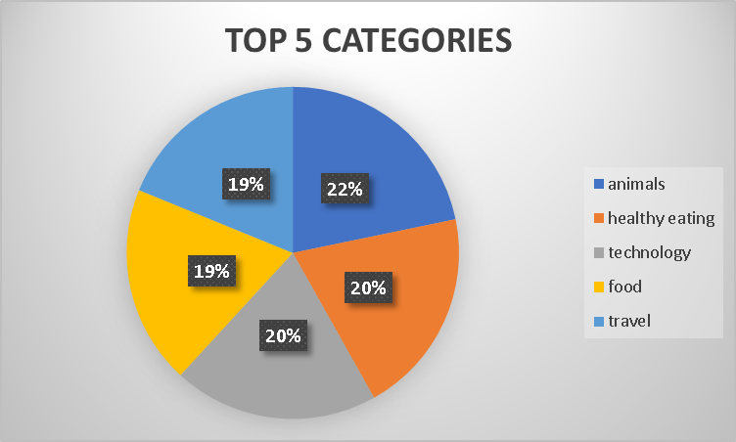

Slide 9
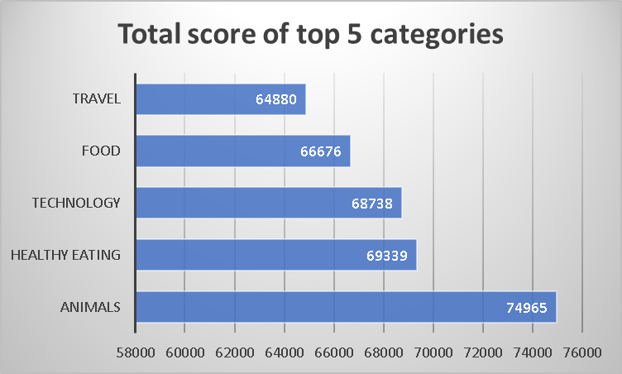

Slide 10

Analysis :
Animal and Science are the two most popular categories of content, showing that people enjoy “real-life” and “Factual” content the most.
Summary
Insight :
Food is a common theme with the top 5 categories with “Healthy Eating” ranking the highest. This may give an indication to the audience within your user base. We could use this insight to create a campaign and work with healthy eating brands to boost user engagement.
Next Step
This ad –hoc analysis is insightful. But It’s time to take this analysis into large scale production for real-time understanding of your business. We can show you how to do this.

Slide 11
Thank you!
ANY QUESTIONS?

